Slide 1
CSE 3207 Applied Statistics and Queuing Theory
Introduction
Md. Shahidul Salim
Lecturer
Dept. of cse, kuet
(Slide modified:
Dr. Sk. Md. Masudul Ahsan
Professor
Dept. of CSE, KUET
)

Slide 2
Introduction
Probability theory and Statistics are branches of mathematics developed to deal with uncertainty.
Uncertainty in computer environment
Arrival of jobs
Execution time
Memory requirement
Failure of components
Exposure to viruses
Errors in codes
etc

Slide 3
What we'll learn
Uncertainty; probabilities of events
Random variables
Stochastic processes
Application:
queuing systems
Statistical inference
Estimation
Testing hypothesis

Slide 4
Ridge regression, Lasso regression
Decision trees, Random forests, Nearest neighbor, and Naive Bayes.
ARIMA
Stationarity
Correlation
Neural networks (Softmax)

Slide 5
Some definitions
experiment = a repeatable process that yields a result or an observation(Tossing of a coin)
outcome = an elementary result of an experiment
sample space = a collection of all possible outcomes of an experiment
denoted by S
sample point / elementary event = an element of S
S={H,T}
event = a set of outcomes (a subset of the sample space)
A sample space of n outcomes yields 2^{n} possible events.
certain event (S) = happens with certitude at each repetition of an experiment
impossible event (φ) = never takes place in a random experiment

Slide 6
Some definitions
A sample space is discrete if it consists of a finite or countable infinite set of outcomes.
A sample space is continuous if it contains an interval (either finite or infinite) of real numbers. (temperature)
Example:
Rolling a die
S = {1, 2, 3, 4, 5, 6}
S= {odd, even}
Tossing a coin
S = {H, T}
Tossing a coin, if head comes roll a die else toss again
S = {H1, H2, H3, H4, H5, H6, TH, TT}
Depends on the objective

Slide 7

Some definitions
Example:
Sample spaces with a large or infinite number of sample points are best described by a statement or rule method.
S is the set of all points (x, y) on the boundary or the interior of a circle of radius 2 with center at the origin
S = { x | x is a city with a population over 1 million}

Slide 8
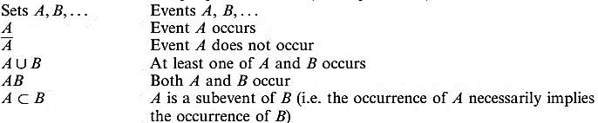
Operations with Events
The language and concepts of set theory provide a natural context for the development of probability theory

Slide 9
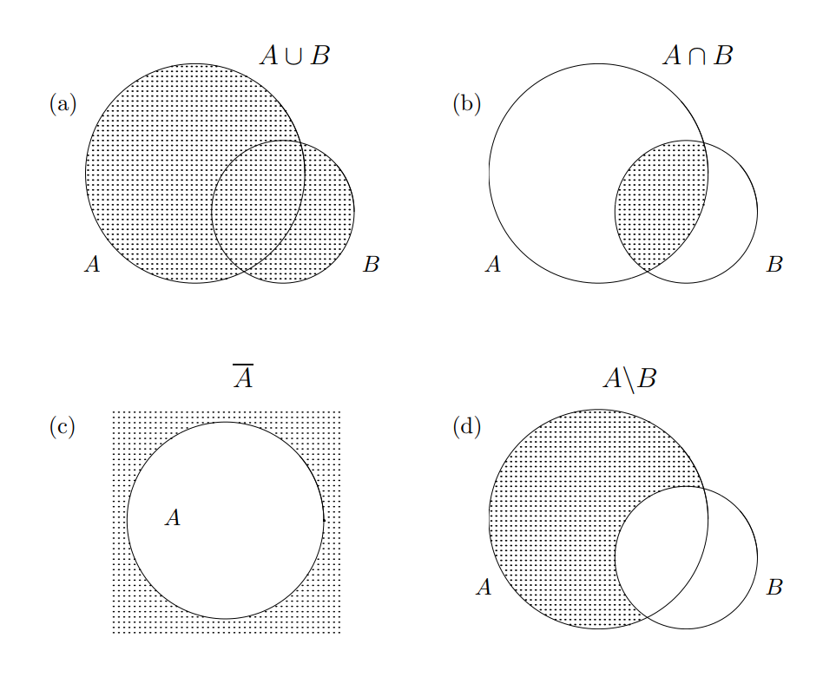

Slide 10
Operations with Events
A \ B (difference ) = = the event A occurs but B does not
Events A, B, C,.. are disjoint (or mutually exclusive)
if A inters B inters C … = φ
disjoint events cannot occur at the same time
Events A, B, C, … are exhaustive if A ∪ B ∪ C ∪ … = S
Commutative law E ∪ F = F ∪ E EF =FE Associative law (E ∪ F ) ∪ G = E ∪ (F ∪ G ) (EF )G = E(FG ) Distributive law (E ∪ F )G = EG ∪ FG EF ∪ G = (E ∪ G )(F ∪ G )

Slide 11


Counting Techniques
Multiplication rule. If an experiment consists of k components (sub-experiments) for which the number of possible outcomes are n₁, n₂, …, n_{k} then the total number of experimental outcomes (the size of the sample space) is equal to n₁× n₂ × … × n_{k}.
The number of permutations of n distinct objects taken r at a time is
The number of combinations of n distinct objects taken r at a time is
Many other permutation/combination rules

Slide 12
Counting Examples
The design for a Website is to consist of four colors, three fonts, and three positions for an image. From the multiplication rule, 4 × 3 × 3 = 36 different designs are possible.
An electronic controlling mechanism requires 5 distinct, but interchangeable, memory chips. In how many ways can this mechanism be assembled
by placing chips in the odd numbered positions within the controller?
Ans: ⁵P₃
A young boy asks his mother to get 5 Game-BoyTM cartridges from his collection of 10 arcade and 5 sports games. How many ways are there that his mother can get 3 arcade and 2 sports games?
Ans: ¹⁰C₃ × ⁵C₂ = 1200

Slide 13
Probability
Probability in daily life conversation
“It is very likely that the plane will arrive late”
“The chances are good that he will be able to join us for dinner”
Probability is used to quantify the
chance ( common sense) (I have a fifty-fifty chance of getting an even number when a die is tossed)
likelihood (forecasting) (The university is not likely to win the football game tonight)
long-term proportion (relative frequency)
past information or from an understanding of the structure of the experiment,
that an outcome of a random experiment will occur.
“The chance of rain today is 30% “

Slide 14

Axioms of Probability
Axiom 1: for each event A in S, P(A) ≥ 0 (nonnegative).
Axiom 2: P(S) =1 (normed).
Axiom 3: for a collection of mutually exclusive events A₁, A₂, . . . in S
Probability. A probability measure, or simply a probability, on a sample space S is a specification of numbers P(A) for all events A that satisfy Axioms 1, 2, and 3.
function of an event = P(E)
Domain: events
Range: [0, 1]
(additive).

Slide 15

Assignment of Probability
Axioms of probability define the properties of a probability measure
However, they do not guide us in assigning probabilities to various events
For problems in applied sciences, a natural way to assign the probability of an event is through the observation of relative frequency.
If an experiment can result in any one of N different equally likely outcomes, and if exactly n of these outcomes correspond to event A, then the probability of event A is
Two events A and B are equally likely if there is no reason to suppose that the occurrence of one is favored with respect to the other.

Slide 16
Assignment of Probability
subjective approach to probability assignment is relative likelihood.
it is not feasible or is impossible to perform an experiment a large number of times
the probability assigned as a result of subjective judgement.
The statement ‘there is a 40% probability of rain tomorrow’
where the number 0.4 is assigned on the basis of available information and professional judgement

Slide 17
Probability Example
A coin is tossed twice. What is the probability that at least 1 head occurs?
S = {HH, HT, T H, T T}
Let, coin is balanced, each outcomes are equally likely.
we assign a probability of ω to each sample point.
Then 4ω = 1, or ω = 1/4.
If A represents the event of at least 1 head occurring, then
A = {HH, HT, T H} and P (A) = ¼ + ¼ + ¼ =3/4

Slide 18
Probability Example
A die is loaded in such a way that an even number is twice as likely to occur as an odd number. If E is the event that a number less than 4 occurs on a single toss of the die, find P(E).
let A be the event that an even number turns up and let B be the event that a number divisible by 3 occurs.
Find P (A ∪ B) and P (A ∩ B).
A = {2, 4, 6} and B = {3, 6}
A ∪ B = {2, 3, 4, 6} and A ∩ B = {6}.
P (A ∪ B) = 2/9 + 1/9 + 2/9 + 2/9 = 7/9
P (A ∩ B) = 2/9

Slide 19
Probability Example
During some construction, a network blackout occurs on Monday with probability 0.7 and on Tuesday with probability 0.5.
What is the probability that blackout will appear on Monday or Tuesday?
Then, does it appear with probability 0.7+ 0.5 = 1.2?
Obviously not, because probability be between [ 0 – 1 ]
Probabilities are not additive here because blackouts on Monday and Tuesday are not mutually exclusive. P(A and B)=0. Do not occur same time. Counts twice(overestimation)
In other words, it is not impossible to see blackouts on both days.

Slide 20
Rules of Probability
P( φ) = 0
Addition rule
If A and B are any events in S, then P(A ∪ B) = P(A) + P(B) - P(A ∩ B)
For mutually exclusive events, P(A ∪ B) = P(A) + P(B)
Complement rule P (A’) = 1 - P (A).

Slide 21
Rules of Probability - Independent events
Events A and B are independent if they occur independently of each other,
i.e., occurrence of one event does not affect the probability of other.
Decide which pair of events are dependent or independent.
1. Toss a coin. Then roll a number cube (die).
2. Choose a bracelet and put it on. Choose another bracelet.
3. Select a card. Do not replace it. Then select another card.
4. Select a card. Replace it. Select another card.
5. Pick one flower from a garden, then pick another.
1,4 – independent
For independent events – multiplicative rule
P(A∩B) = P(A) P(B )
P (E₁ ∩ ... ∩ E_{n}) = P(E₁)x ... x P(E_{n})

Slide 22
Example
There is a 5% probability for a hard drive to crash. Therefore, it has a backup having a 10% probability to crash, and all components are independent of each other. The stored information is lost only when all devices crash. What is the probability that the information is saved?
H = { hard drive crashes } B = {backup crashes }
P (H) = 0.05, and P(B) = 0.1
P (saved) = 1 – P(lost)
= 1 - P (H ∩ B) = 1 – P(H) P(B)
= 1 – 0.05*0.1
= 0.995

Slide 23
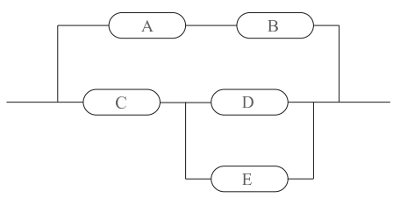
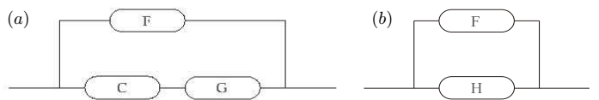
Example
Calculate reliability of the system in Figure if each component is operable with probability 0.92 independently of the other components.
P(A ∩ B) = (0.92)² = 0.8464 = P(F)
P(D ∪ E) = 1 - P {D ∪ E} ‘
= 1- P {D’ ∩ E’}
= 1 - (1 - 0.92)² = 0.9936 = P(G)
P (C ∩ G) = 0.92 · 0.9936 = 0.9141 = P(H)
P (F ∪ H) = 1 - (1 - 0.8464)(1 - 0.9141)
= 0.9868

Slide 24
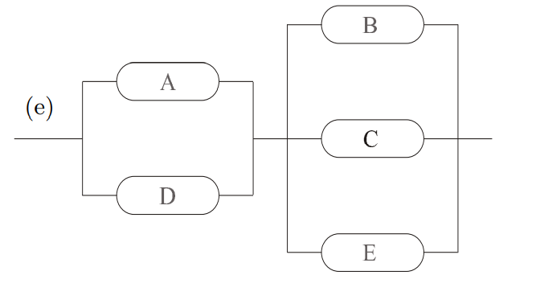
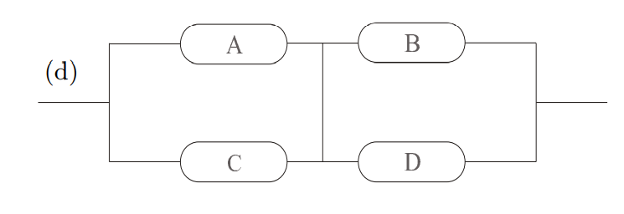
DIY

Slide 25

Rules of Probability(83W)
Conditional Probability
The conditional probability of B, given A, is defined by
provided P (A) > 0.
The even numbers are twice as likely to occur as the odd numbers.
The probability of B, given A
B = {perfect square} = {1, 4}, P(B) = 1/9 + 2/9 = 1/3
A = {greater than 3} = {4, 5 , 6} ,P(A)=2/9+1/9+2/9=5/9
(A ∩ B)={4} , P(A∩B)= 2/9
No. is a perfect sq, and it is known that no > 3
P(B|A) = (2/9)/(5/9) = 2/5

Slide 26
Rules of Probability(53b)
Conditional Probability – example
Ninety percent of flights depart on time. Eighty percent of flights arrive on time. Seventy-five percent of flights depart on time and arrive on time.
You are meeting a flight that departed on time. What is the probability that it will arrive on time?
A = {arriving on time} , D = {departing on time} . P (A) = 0.8, P (D) = 0.9, P(A ∩ D) = 0.75.
P(A | D) = P (A ∩ D) / P(D) = 0.75 / 0.9 = 0.8333

Slide 27
One bag contains 4 white balls and 3 black balls, and a second bag contains 3 white balls and 5 black balls. One ball is drawn from the first bag and placed unseen in the second bag. What is the probability that a ball now drawn from the second bag is black?

Slide 28
Rules of Probability (89W)
General multiplicative rule
P(A∩B) = P(A) P(B|A ) = P(B) P(A|B )
Two events A and B are independent if and only if P (B|A) = P (B) or P (A|B) = P (A)
Three cards are drawn in succession, without replacement, from an ordinary deck of playing cards. Find the probability that the event A1 ∩ A2 ∩ A3 occurs, where A1 is the event that the first card is a red ace, A2 is the event that the second card is a 10 or a jack, and A3 is the event that the third card is greater than 3 but less than 7.

Slide 29
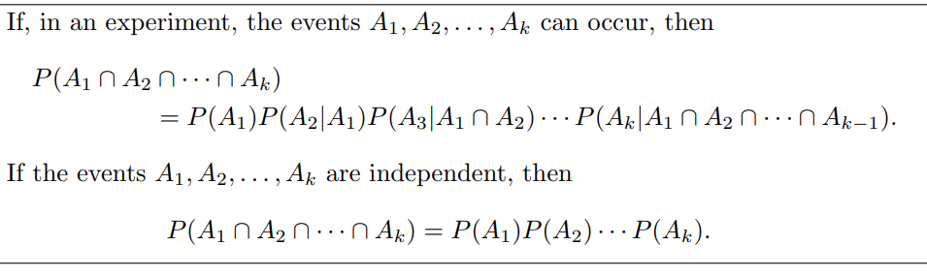
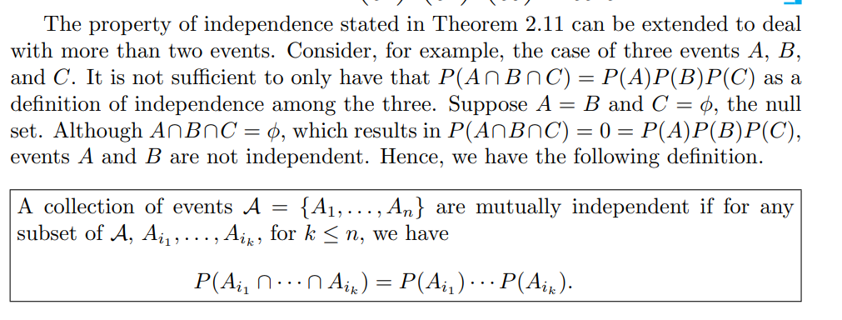

Slide 30

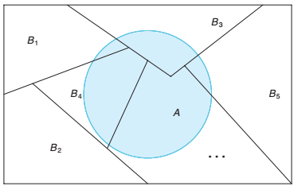
Rules of Probability(53B)
Partitions: A collection of sets B₁, B₂, . . . , B_{k} is said to partition the sample space if the sets
are mutually disjoint and (ii) have as union the entire sample space.
Total Probability
If the events B1, B2, . . . , Bk constitute a partition of the sample space S such that P (Bi) ≠ 0 for i = 1, 2, . . . , k, then for any event A of S
Partitioning the sample space S.

Slide 31

Rules of Probability - Bayes’ Rule
Two events
General
If B₁, B₂, . . . , B_{n} partition the sample space S, then for each i = 1, 2, . . . , n and any set A
prior probabilities are P (B_{i})
Posterior probabilities are P (B_{i}|A)
Notes:
Bayes’ Rule can be interpreted in terms of prior
and posterior probabilities. The prior probabilities are P (Bi), i.e., the (ordinary)
probability that the event Bi occurs. Bayes’ Rule shows how these probabilities
change if we know that event A has occurred; namely it gives a formula for P (Bi|A),
the conditional probability that Bi occurs given that A has occurred. The latter
probabilities are called posterior probabilities. (The terms “prior” and “posterior”
come from Latin and mean “before” and “after”.)

Slide 32
Recognizing conditional probabilities
: Conditional probabilities are often indicated by words/phrases like “given that”, or “if”, or by words implying a subpopulation. Here are some examples of statements (mostly taken from actuarial exam problems) that refer to a conditional probability, along with their translation into
– “5 percent of those taking drugs test negative.”
Translation: “P(test negative | take drugs) = 0.05.”
– “For each smoker, the probability of dying during the year is 0.05”
Translation: “P(dying | smoker)=0.05”
– “A blood test indicates the presence of a disease 95% of the time the disease is
actually present.”
Translation: “P(test indicates disease | has disease)=0.95”
– “Males who have a circulation problem are twice as likely to be smokers as those
who do not have a circulation problem.”
Translation: “P(smoker | circulation problem)=2 P(smoker | no circulation problem)

Slide 33
Bayes’ Rule - example
The probability that a medical diagnostic test correctly identifies someone with the illness as positive is 0.99, and the probability that the test correctly identifies someone without the illness as negative is 0.95. The incidence of the illness in the general population is 0.001.
You take the test, and the result is positive. What is the probability that you have the illness?
D = {you have the illness}, S= {test signals positive}
Here, P(D) = 0.001, P(S|D) = 0.99, P(S’|D’) = 0.95,
P(S|D’) = 0.05
From Bayes’ theorem, P(D|S) = P(S|D) P(D) /[ P(S|D) P(D) + P(S|D’) P(D’) ] = 0.99 *0.001 /[0.99 *0.001 +0.05 *(1-0.001)] =0.02

Slide 34
Bayes’ Rule - example
DIY
A new computer program consists of two modules. The first module contains an error with probability 0.2. The second module is more complex; it has a probability of 0.4 to contain an error, independently of the first module. An error in the first module alone causes the program to crash with probability 0.5. For the second module, this probability is 0.8. If there are errors in both modules, the program crashes with probability 0.9. Suppose the program crashed. What is the probability of errors in both modules?

Slide 35
Bayes’ Rule - example
Sol
A = {errors in module I} , B = {errors in module II} ,
C = {crash} .
{errors in module I alone} = A\B = A\(A ∩ B)
{errors in module II alone} = B\A = B\(A ∩ B).
Given that, P {A} = 0.2, P {B} = 0.4,
P {A ∩ B} = (0.2)(0.4) = 0.08, by independence,
P {C | A\B} = 0.5, P {C | B\A} = 0.8, and P {C | A ∩ B} = 0.9.
We need to compute P {A ∩ B | C}.
Since A is a union of disjoint events A\B and A ∩ B, we compute, P {A\B} = P {A} - P {A ∩ B} = 0.2 - 0.08 = 0.12. Similarly, P {B\A} = 0.4 - 0.08 = 0.32

Slide 36
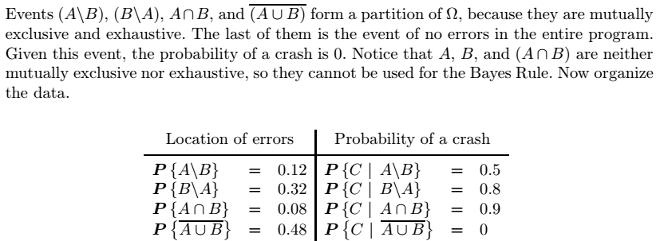


Bayes’ Rule - example
Sol

Slide 37
Ref.
Probability and Statistics for Engineers and Scientists
R E Walpole, R H Myers, S L Myers, K Ye
Probability and Statistics for Computer Scientists
Michael Baron
Operation Research
H A Taha
Operation Research
W L Winston
Additional
Probability and Statistics for Engineers
Richard A. Johnson
Applied Statistics and Probability for Engineers
Douglas C. Montgomery, George C. Runger

